Slide 1


Advanced Topics in R
Nadav Rindler nrindler@gmail.com
Session 15
15 Oct 2017

Slide 2
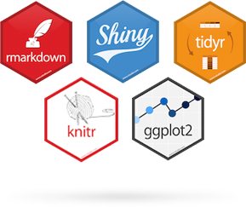


Workshop Format
30 minutes : Introduction & demos
120 minutes : Hands-on exercise

Slide 3
Objectives
Topics in R
Connecting R to databases (RSQLite)
Organize data with Tidyverse
Mapping with Leaflet
Tools to help communicate results
Shiny
Jupyter Notebook
“Full cycle workflow” in R – from data set to published results

Slide 4
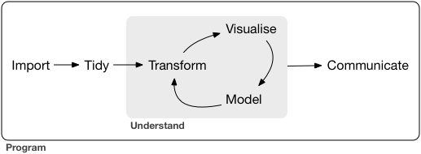
Data science workflow
Image: R for Data Science textbook

Slide 5
Get data: Connect R to database
Access data by connecting R to existing database or data warehouse
Or, for data prep: save large data sets to SQL table to then query and aggregate
Run query in-database; do not have to move a large amount of data into memory
Only return specific columns or aggregated data to R for further analysis
Practical issues
Different R packages depending on the type of SQL or type of connection
Careful with column names and data types to ensure compliance between SQL and R

Slide 6

Analyze data: R + Jupyter Notebook
Run R in Jupyter using R Kernel (R Essentials or IRKernel)
https://www.datacamp.com/community/blog/jupyter-notebook-r#gs.5vewzbU
Change Jupyter Notebook start-up folder:
http://jupyter-notebook-beginner-guide.readthedocs.io/en/latest/execute.html
Initialize Jupyter Notebook and create new R Notebook

Slide 7
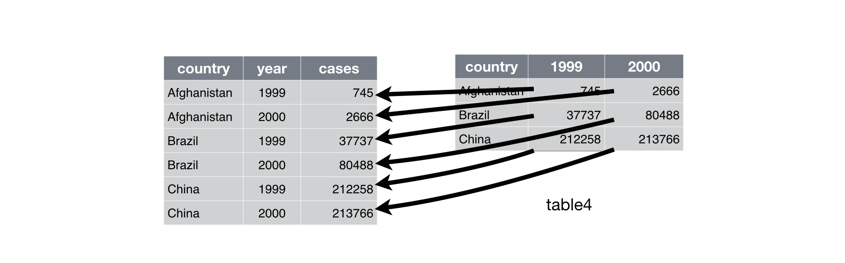
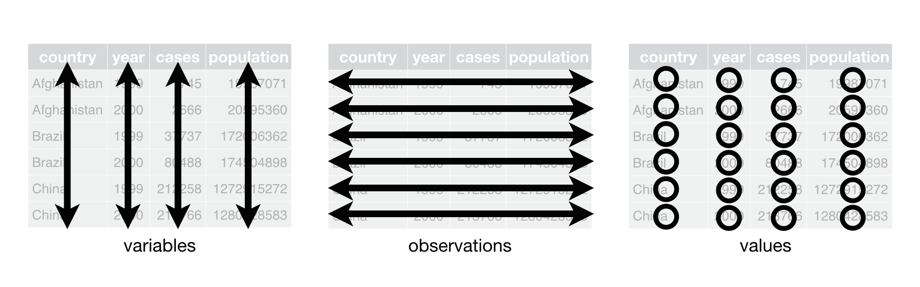
Organize data: Tidyverse
Demo with Jupyter Notebook
The tidyverse is a coherent system of packages for data manipulation, exploration and visualization that share a common design philosophy
Tidy data is a framework to organize data in a consistent manner that facilitates data analysis
Images: R for Data Science textbook

Slide 8
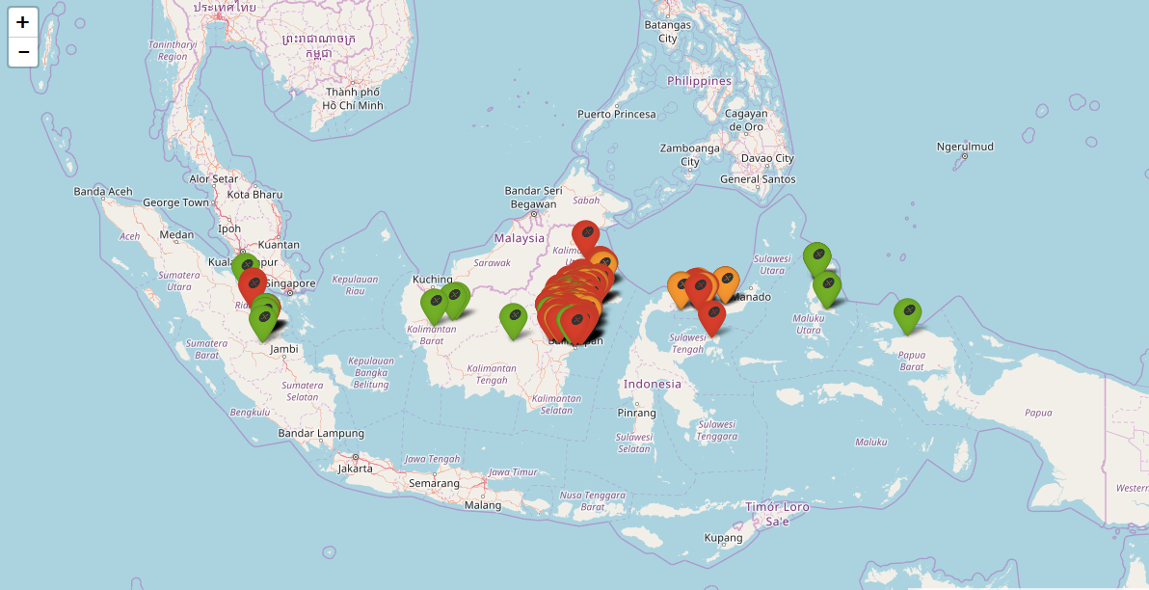
Visualize data: Mapping with Leaflet
Demo in R Studio
https://rstudio.github.io/leaflet
Easy to use, open-source JavaScript library for interactive maps

Slide 9
Communicate results: Shiny Apps
https://nrindler.shinyapps.io/dataviz_pl_shinyapp_sept2017/
Ui.R - user interface elements
Server.R - server/content code
Published to http://www.shinyapps.io/

Slide 10
Additional Topics
Publishing with R Markdown
Cross validation

Slide 11
Hands-On Exercise

Slide 12
References and Resources
http://www.starkingdom.co.uk/creating-an-sqlite-database-with-r/
Shiny Tutorial
Leaflet (Mapping) – has section on creating custom map markers
Tidyverse vignette
DPLYR vignette
Tidy Course (Intro to Tidyverse)
R for Data Science free textbook – built on tidyverse and has section on ‘Tidy Data’
R Fiddle online R interface (if having trouble installing R on your machine)

Slide 13


Got Questions?
Nadav Rindler
nrindler@gmail.com
https://www.linkedin.com/in/nrindler/
Shak Hassan
eskep01@gmail.com
Twitter: @shakhassan
https://my.linkedin.com/in/shakhassan25

